Slide 1
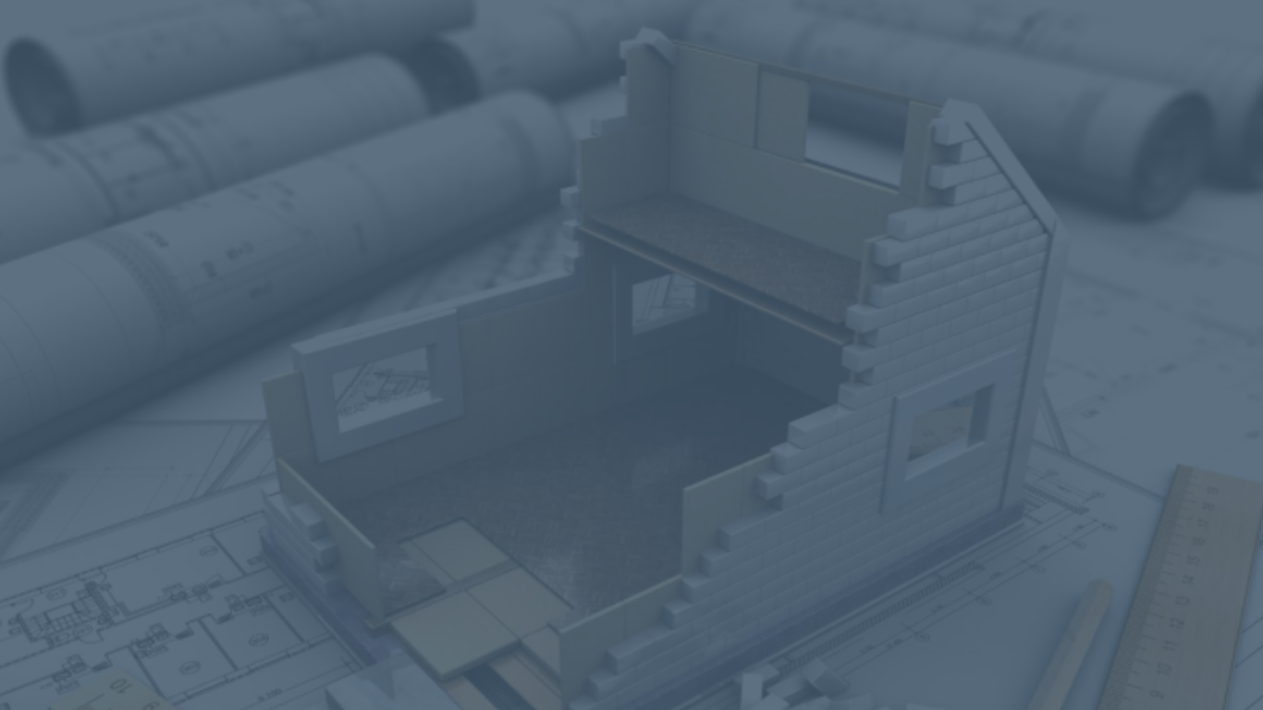


the
HOME
Notes:
Type your notes

Slide 2


Who Are We?
Boothwood White are a developer of a Code 5 equivalent, modular manufactured house which uses advanced technology to create a sustainable home.
The ethos of Boothwood White is to create sustainable and energy efficient spacious homes to promote happier and healthier living.
Our offering is ‘The Home’ and the range consists of two, three or four-bedroom houses and one or two-bedroom apartments, manufactured to a precision standard for the social housing sector.
Notes:
Type your notes

Slide 3







2018
2019
2020
Became aware of the sustainability of the modular homes and how they could impact the future of housebuilding
Watched and researched how the market moved and who was the target market
Planned the mission and built the Boothwood White Showhouse
Notes:
Type your notes

Slide 4
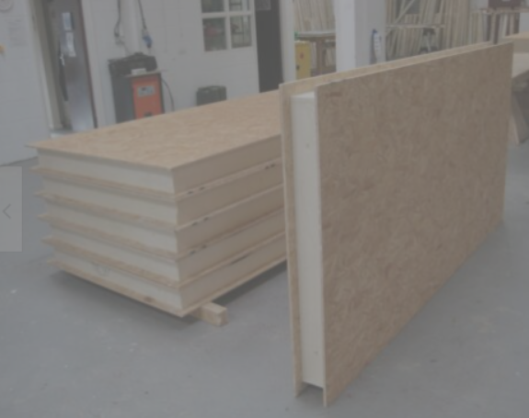
Our Product
We use Structural Insulated Panels (SIPS) that are lightweight, quick to erect and do not suffer from compression shrinkage and cold bridging associated with stud walls
Deliver to site in panel form which reduces our carbon footprint on transportation
SAP rating of 92 which represents an average SAP/EPC rating of Band A
Our panels are built to specific sizes which reduce waste and allow us to provide larger homes
We install solar panels with a smart home automation system to allow families to create and manage their own energy
Notes:
Type your notes

Slide 5
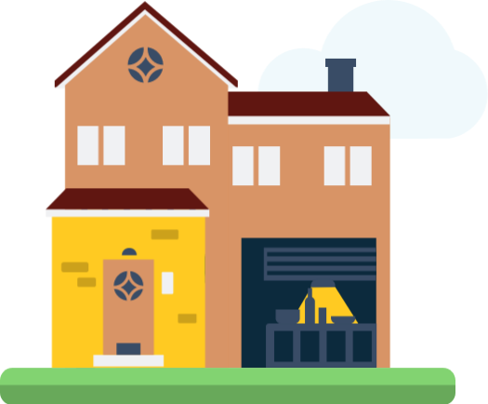
Why Are We Different?
The majority of Modular home suppliers are volumetric which means that although their homes are low to zero carbon and energy efficient, the method of transporting to site is far from. . As BWI construct the majority of the homes on site, this cuts down not only the delivery costs, but the energy consumed to get the materials to site.
In housebuilding in general, it seems that the norm is to comply with the government standard minimum only, in terms of size required. The ethos of BWI is to go above the industry standard giving families homes that are not only more spacious, but highly energy efficient to reduce fuel poverty.
As we build on site, we are not restricted by the size of box delivered to site.
This also allows us to build on small sites of anything from two houses.
Notes:
Type your notes

Slide 6
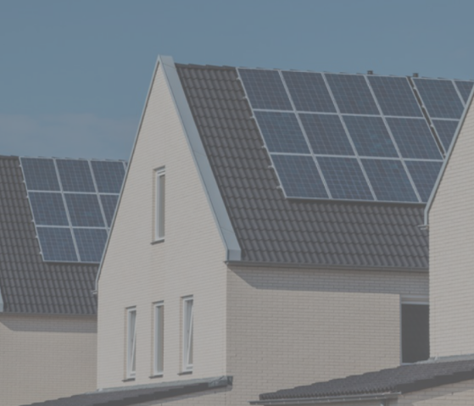
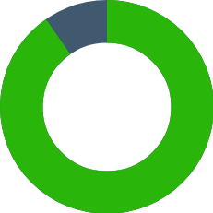
Wondrwall Home Automation
A self learning system that adapts heating and lighting according to routine
Aesthetically designed solar roofing system that generates its own clean energy
Uses an ultra-compact high capacity battery that stores electricity, helping to reduce energy consumption by 90% in conjunction with the solar powered system
Notes:
Type your notes

Slide 7
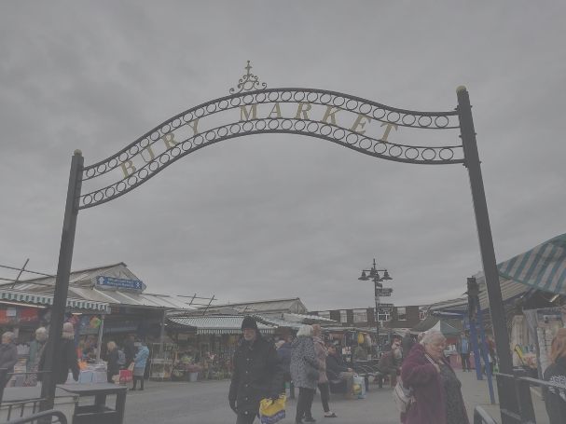

Manchester - The Hub of the Revolution!
Born in Bury, Boothwood White are well placed within the Northwest supply chain
Local workforce to help with increase employment in the area
More houses = more jobs
Apprenticeships for local youths as the company expands
Bring back the 'Jobs for Life' philosophy
Notes:
Type your notes

Slide 8
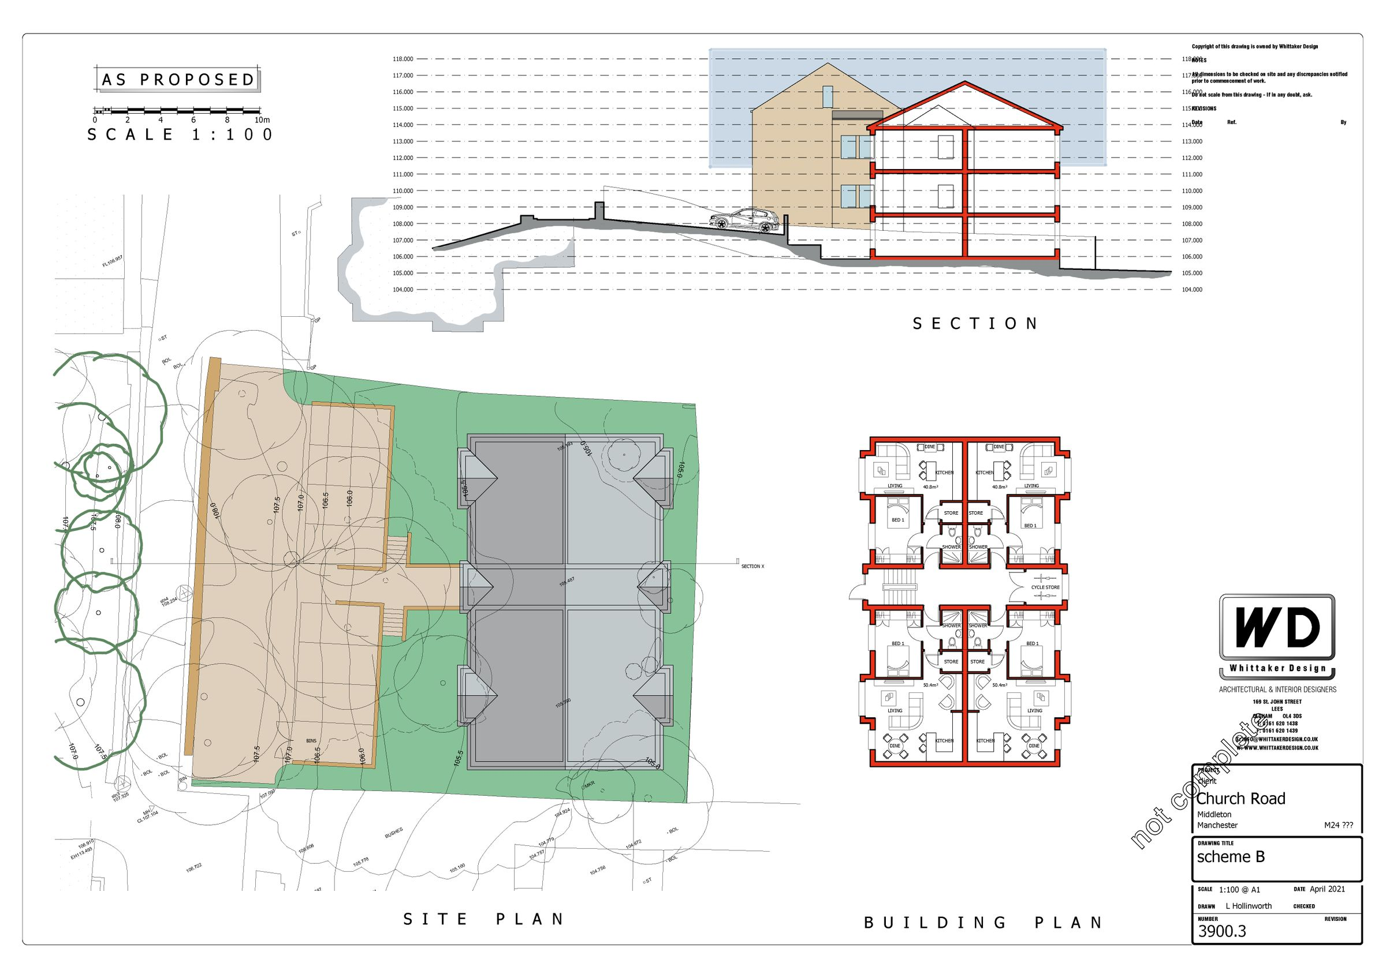
Our Capacity
2021-2022
2 Houses
12 Apartments
2022-2023
30 Houses
2023-2024
45 Houses
Notes:
Type your notes

Slide 9
Thank you
Notes:
Type your notes

